Slide 1
Brain Atlas Analysis
Wen Zhong
2019-01-11

Slide 2
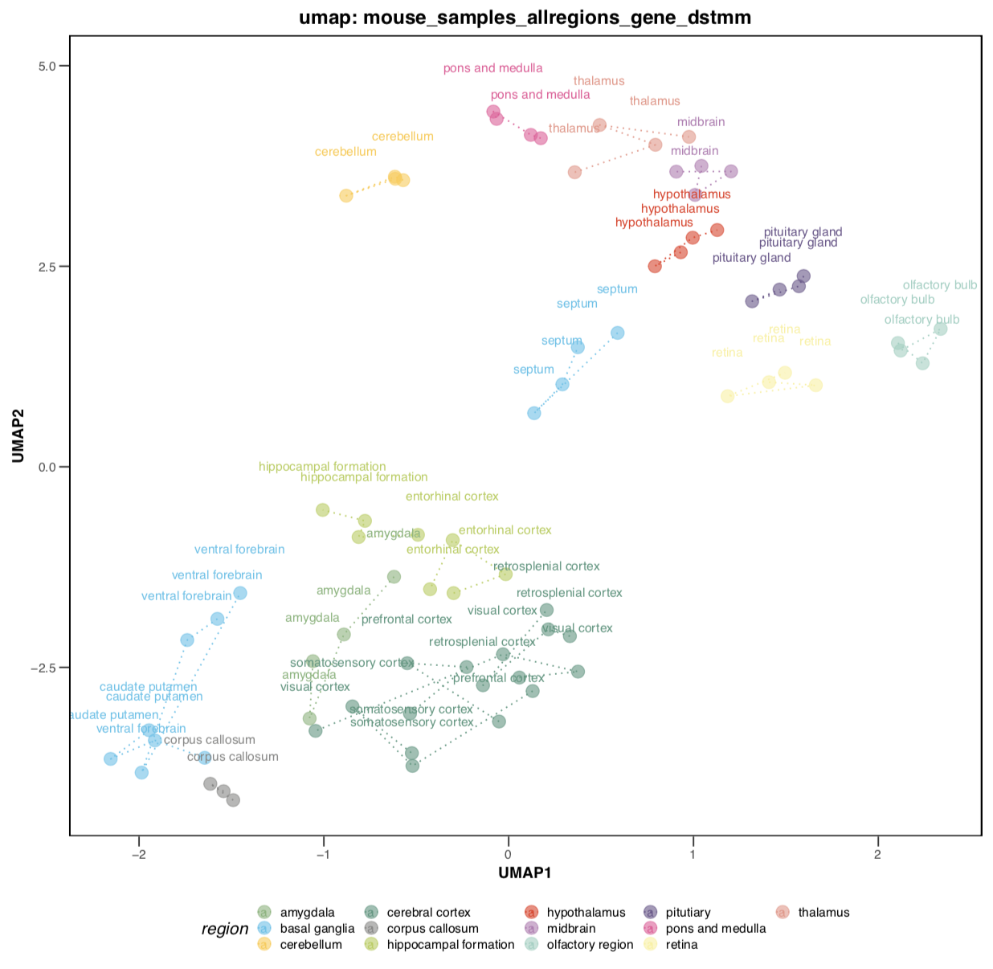
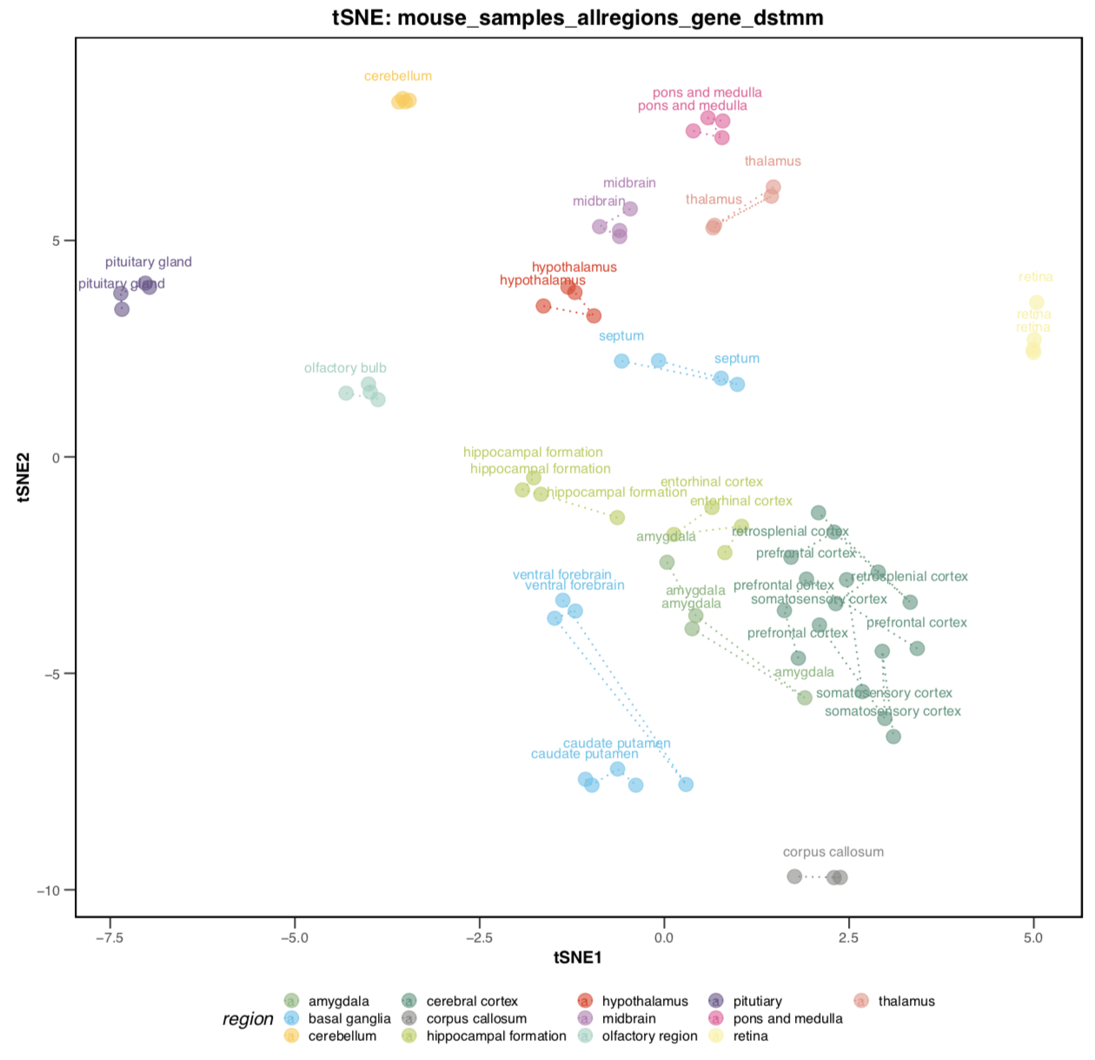
Overview – raw data (mouse, all samples)

Slide 3
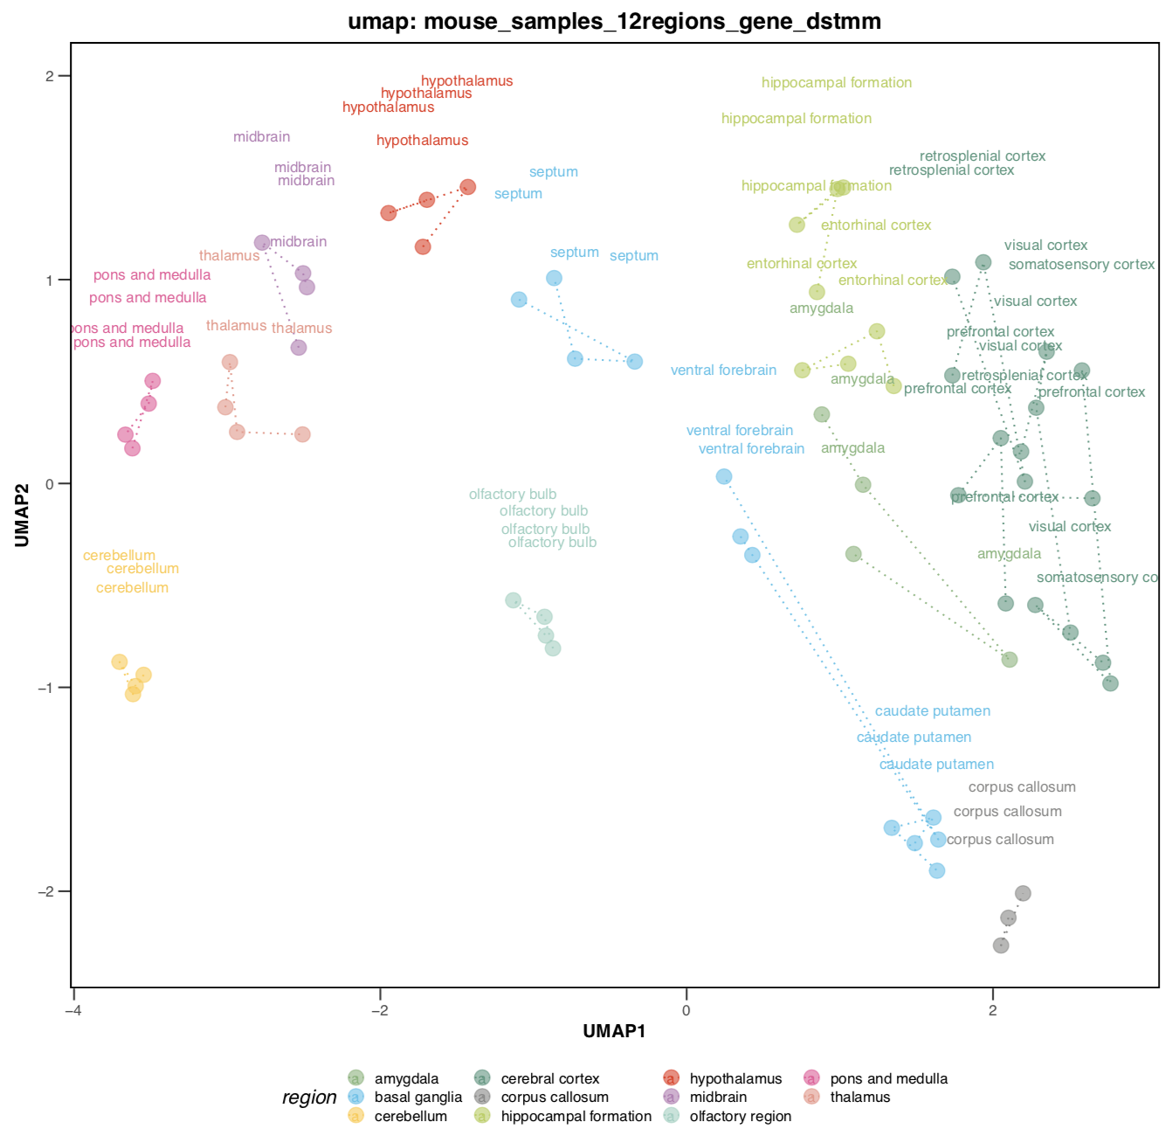
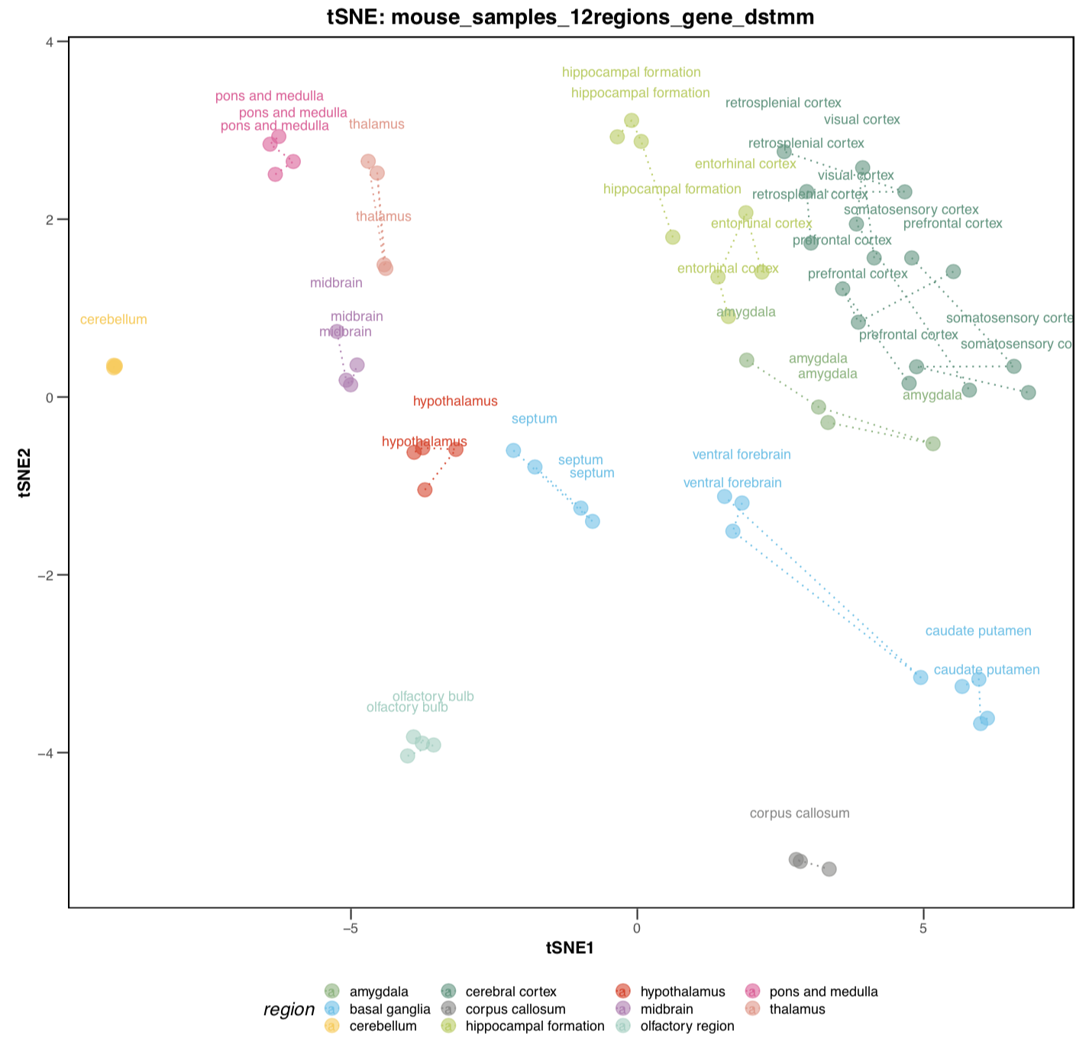
Overview – raw data (mouse, 11 regions)

Slide 4
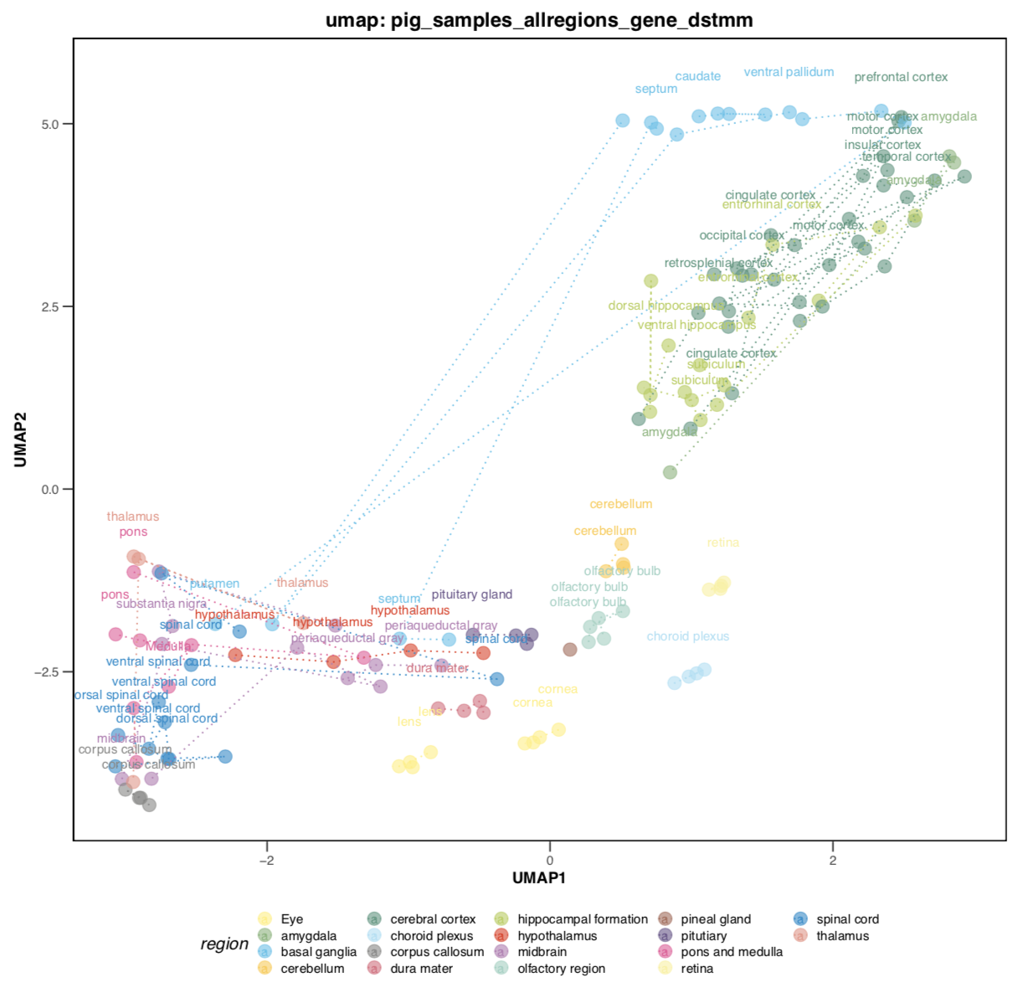
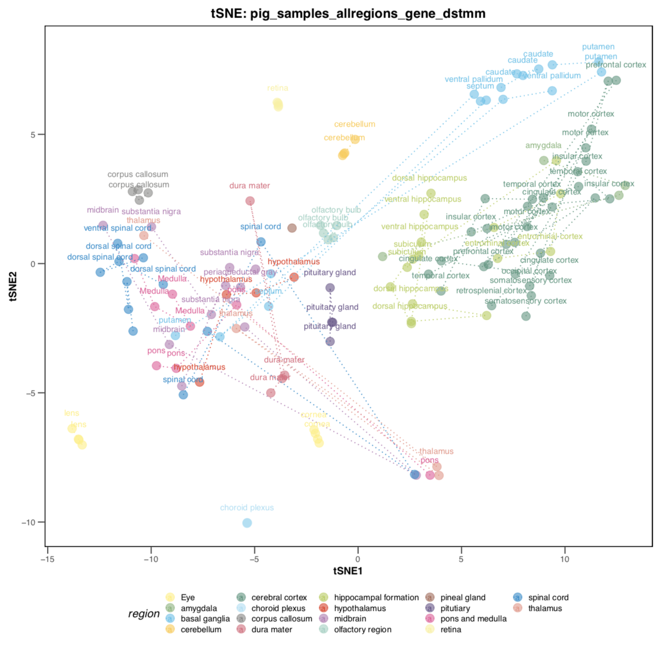
Overview – raw data (pig, all samples)

Slide 5
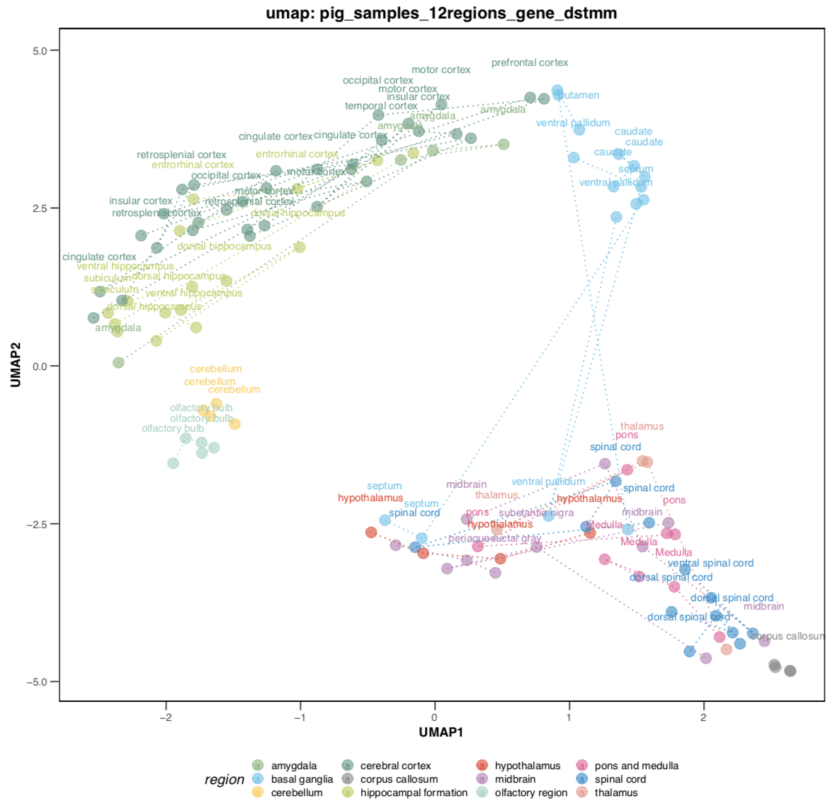
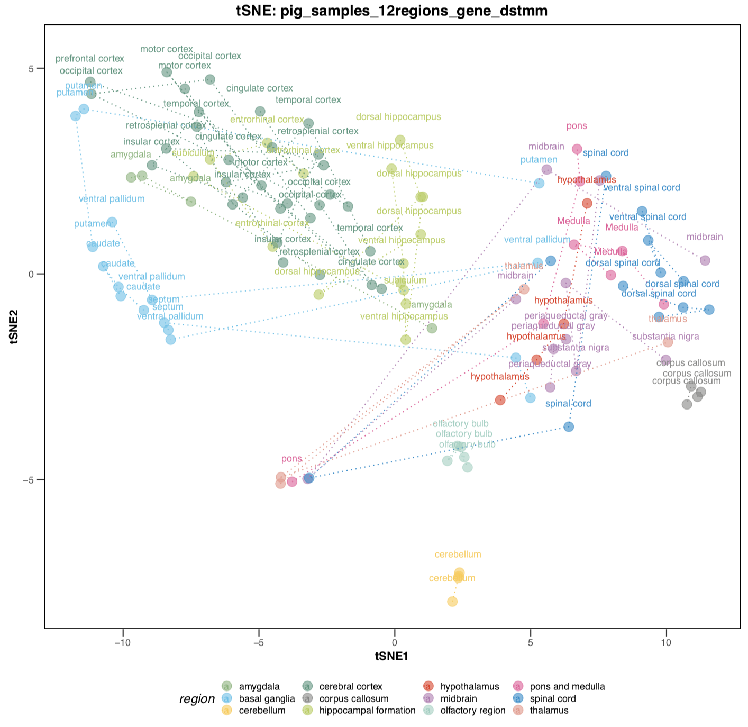
Overview – raw data (pig, 12 regions)

Slide 6
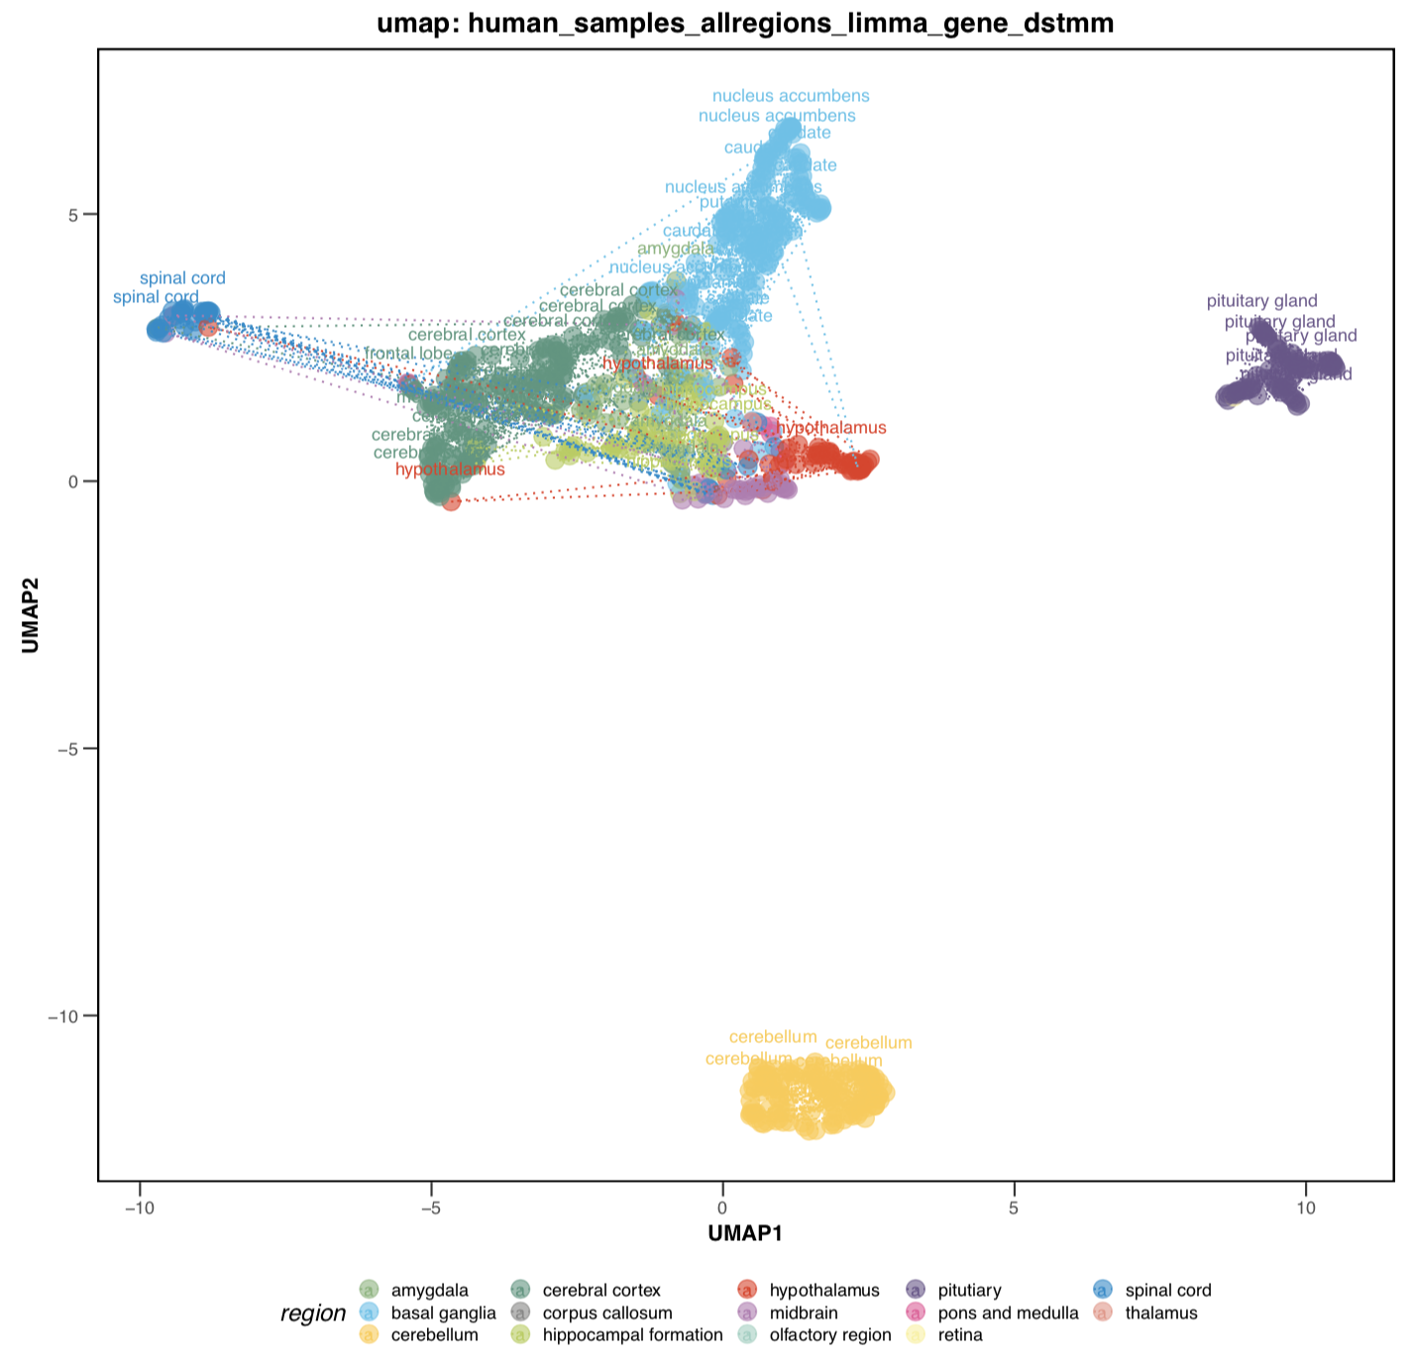
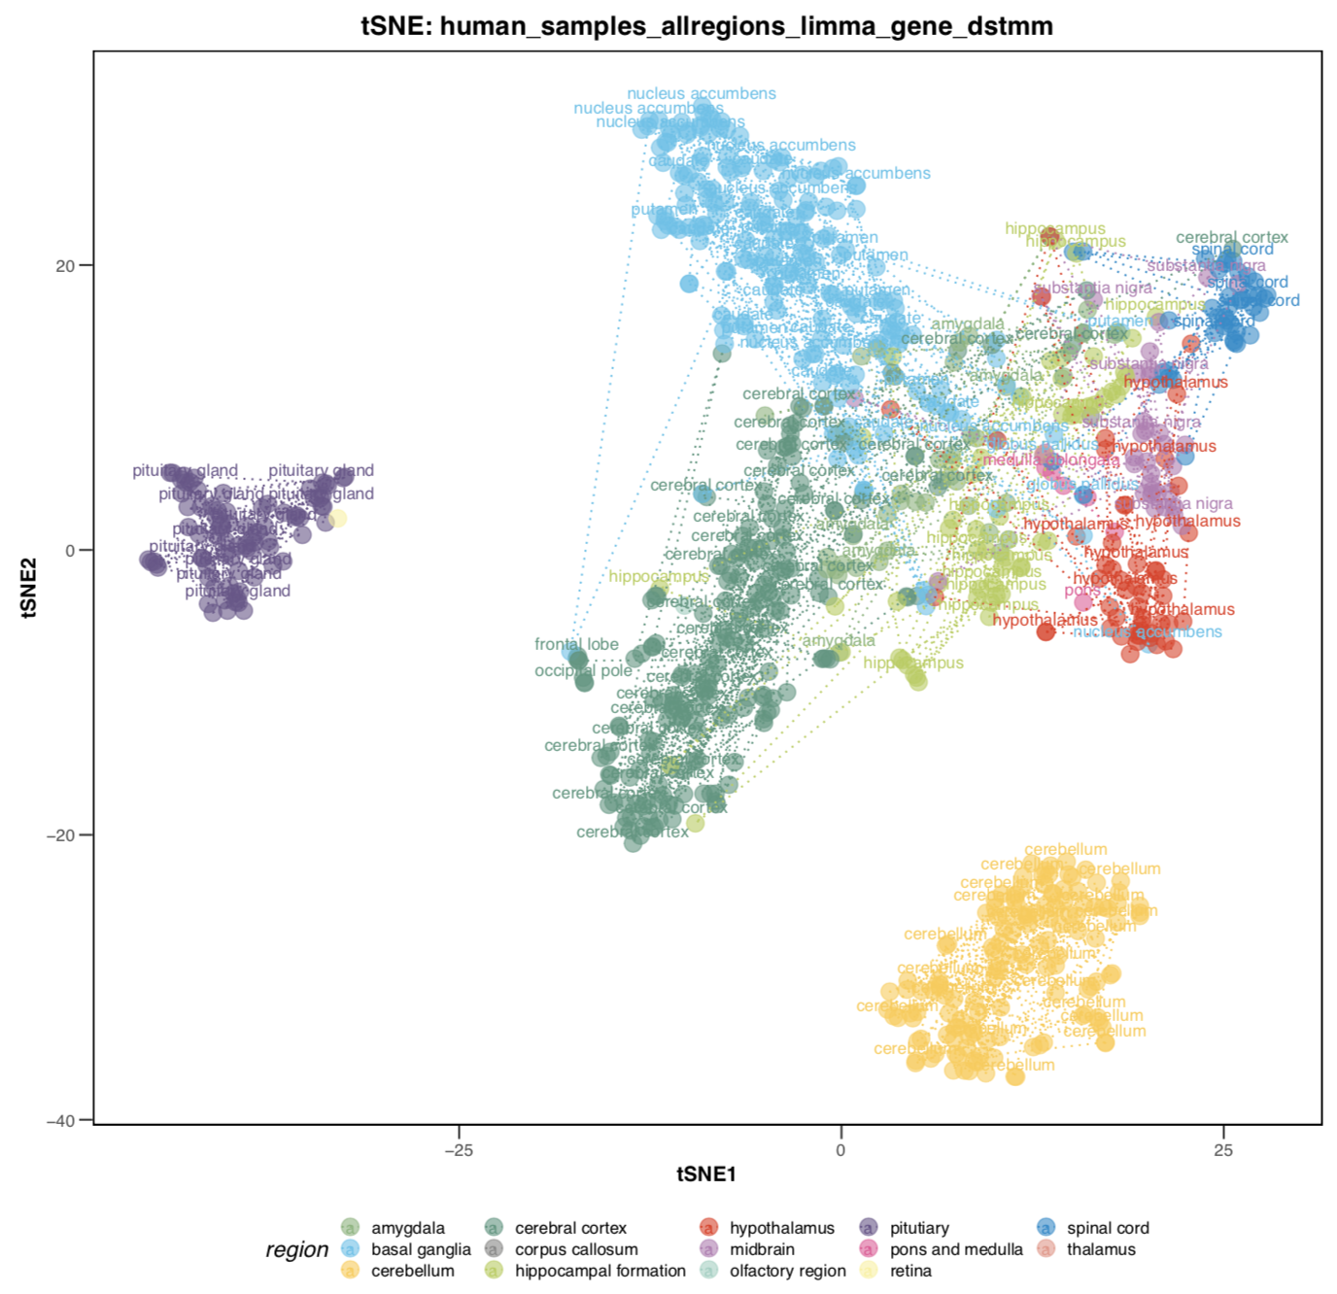
Overview – raw data (human, all samples)

Slide 7
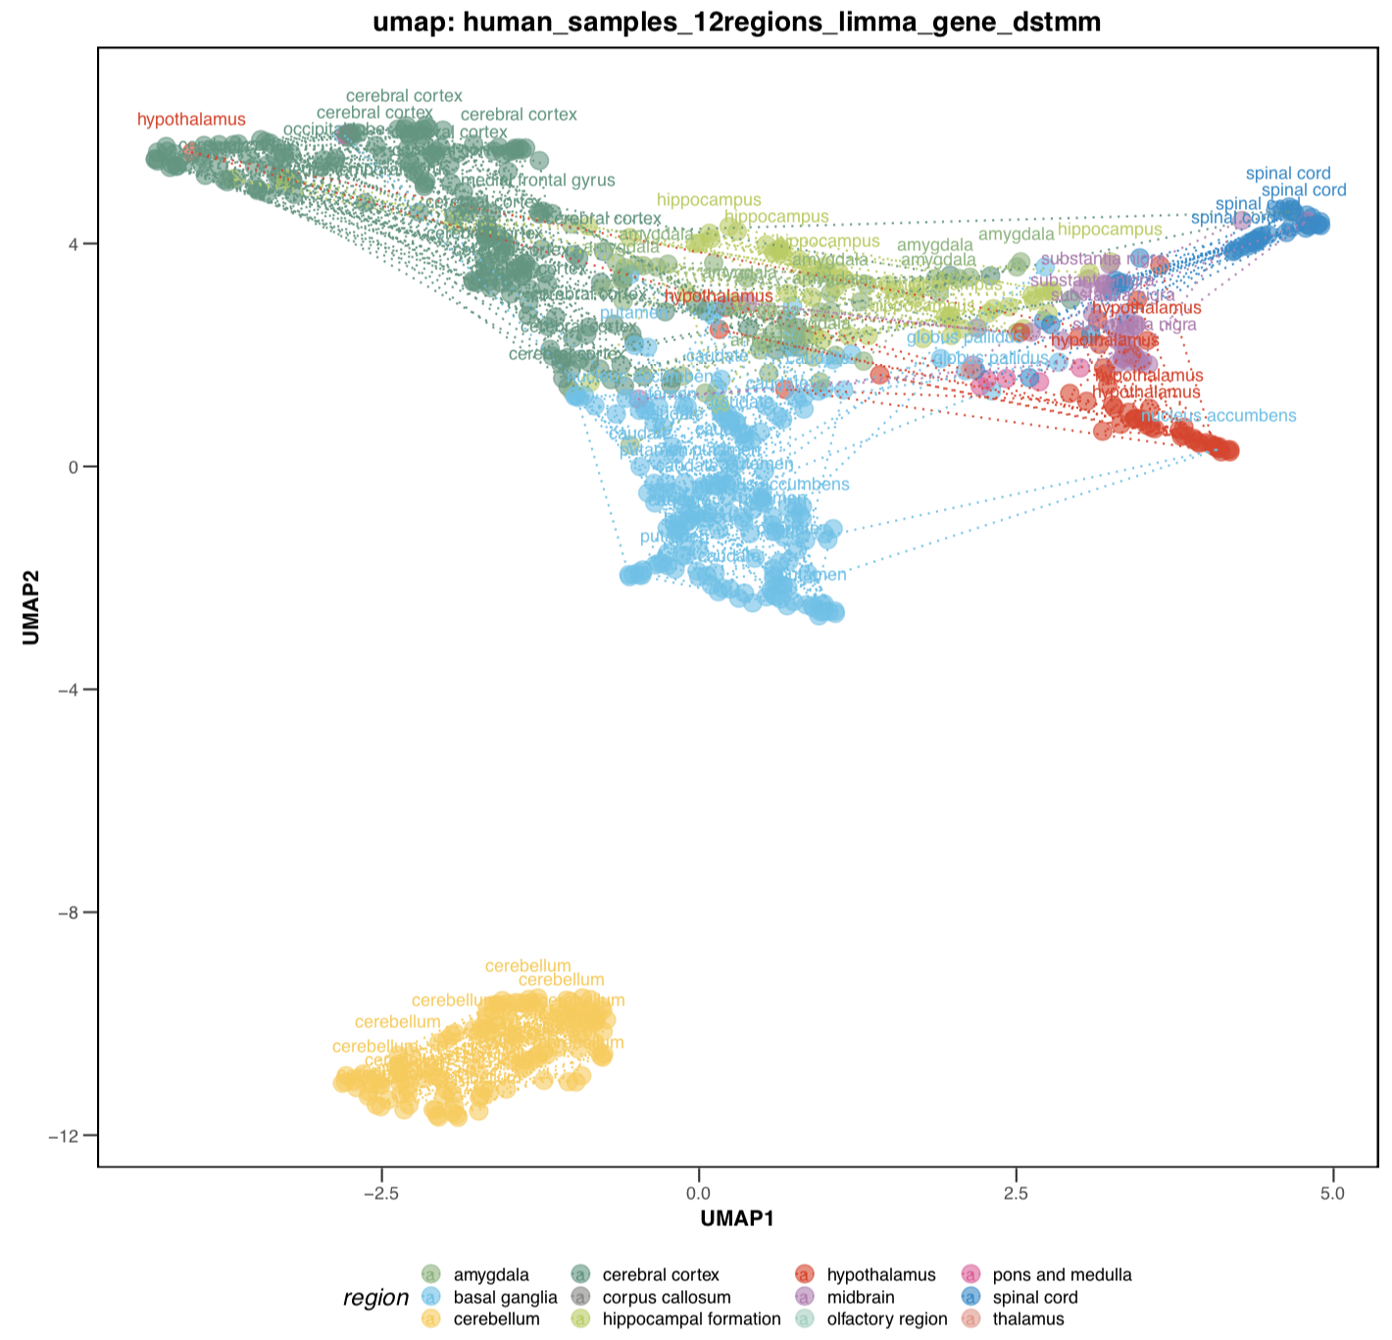
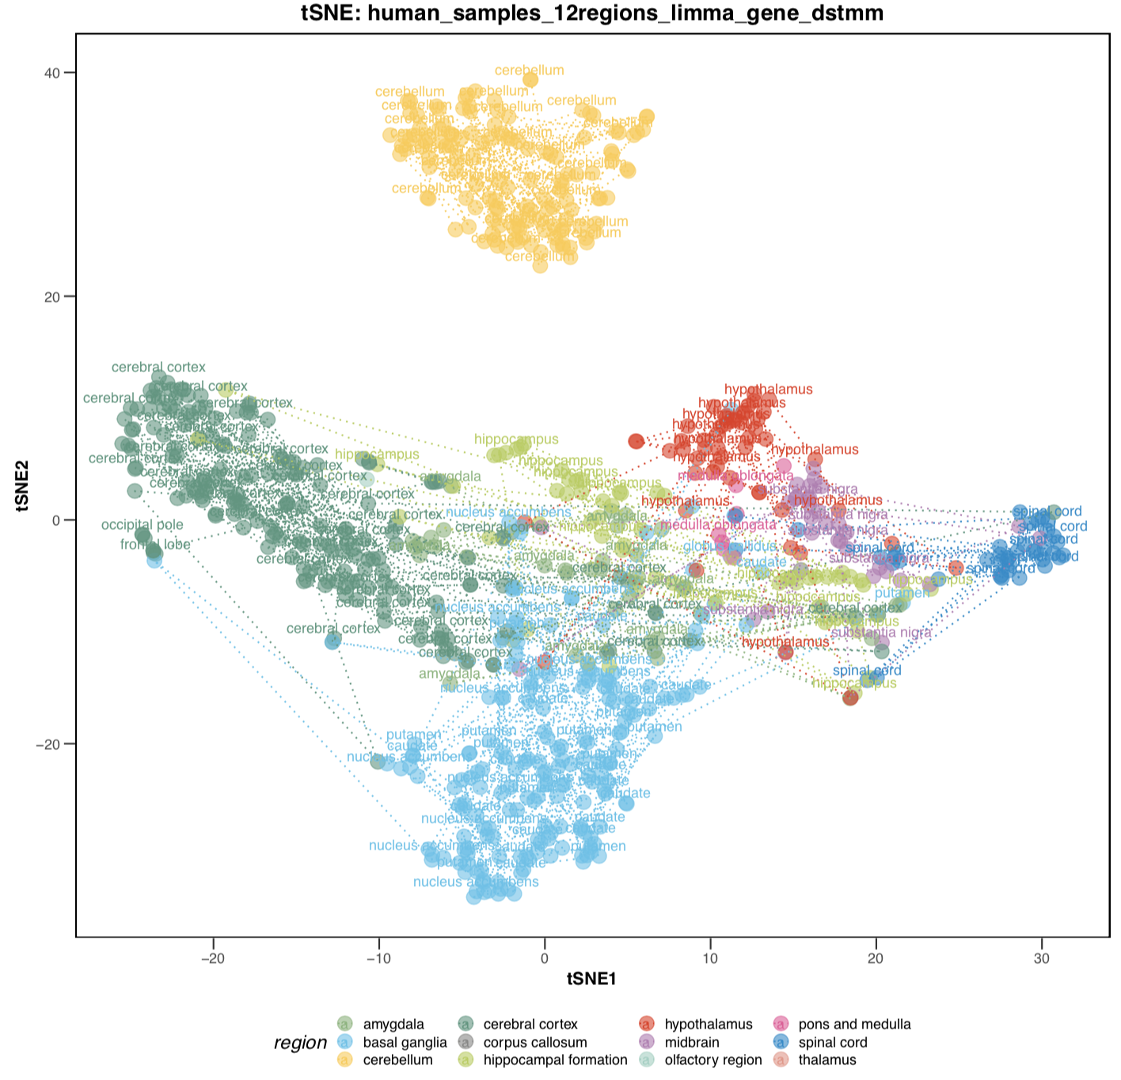
Overview – raw data (human, 12 regions)

Slide 8
Overview – Consensus results

Slide 9
Overview – Categories of genes

Slide 10
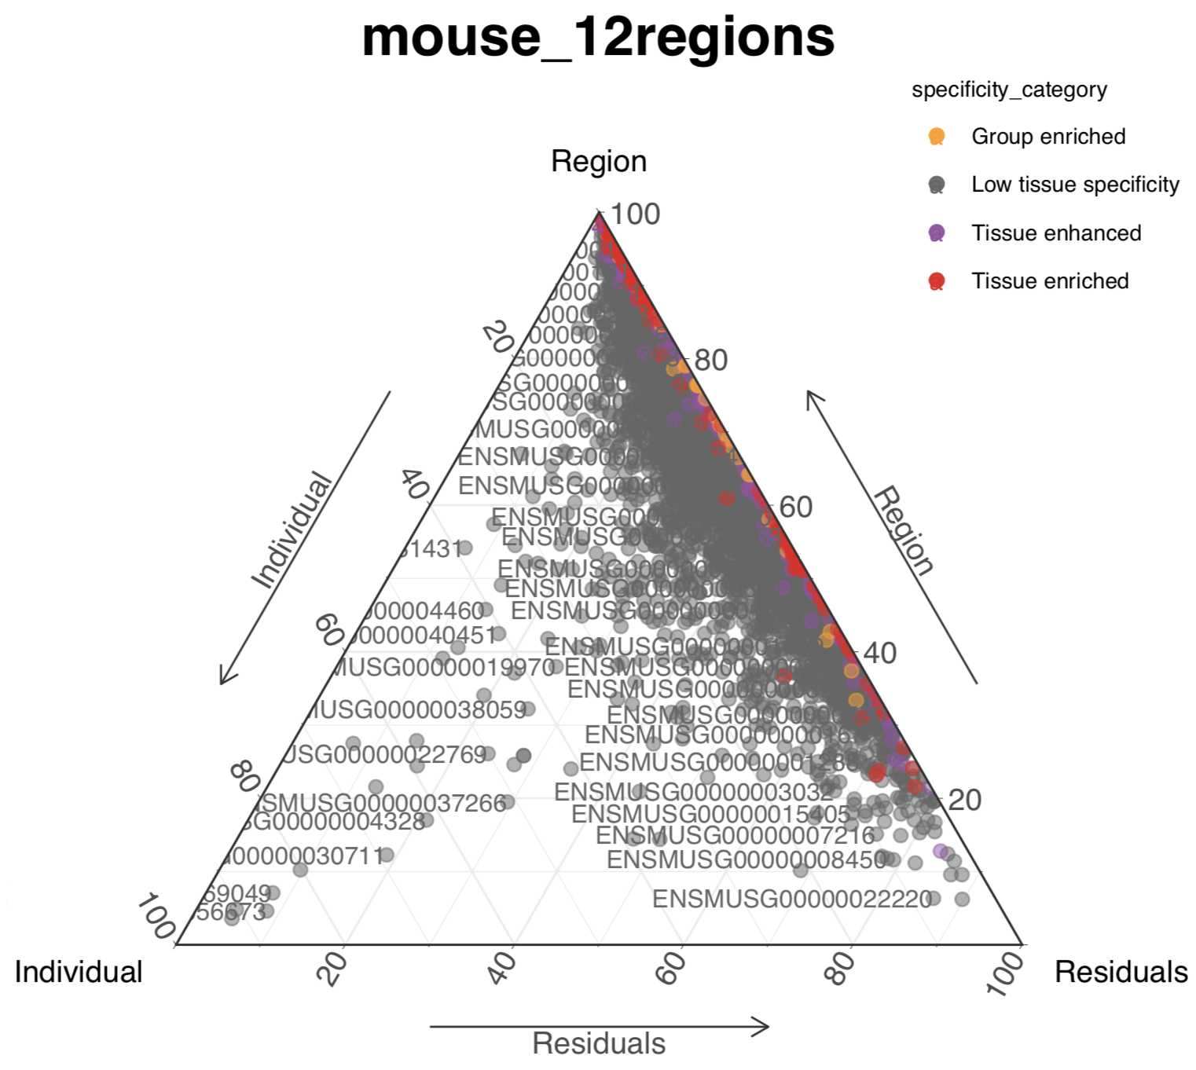
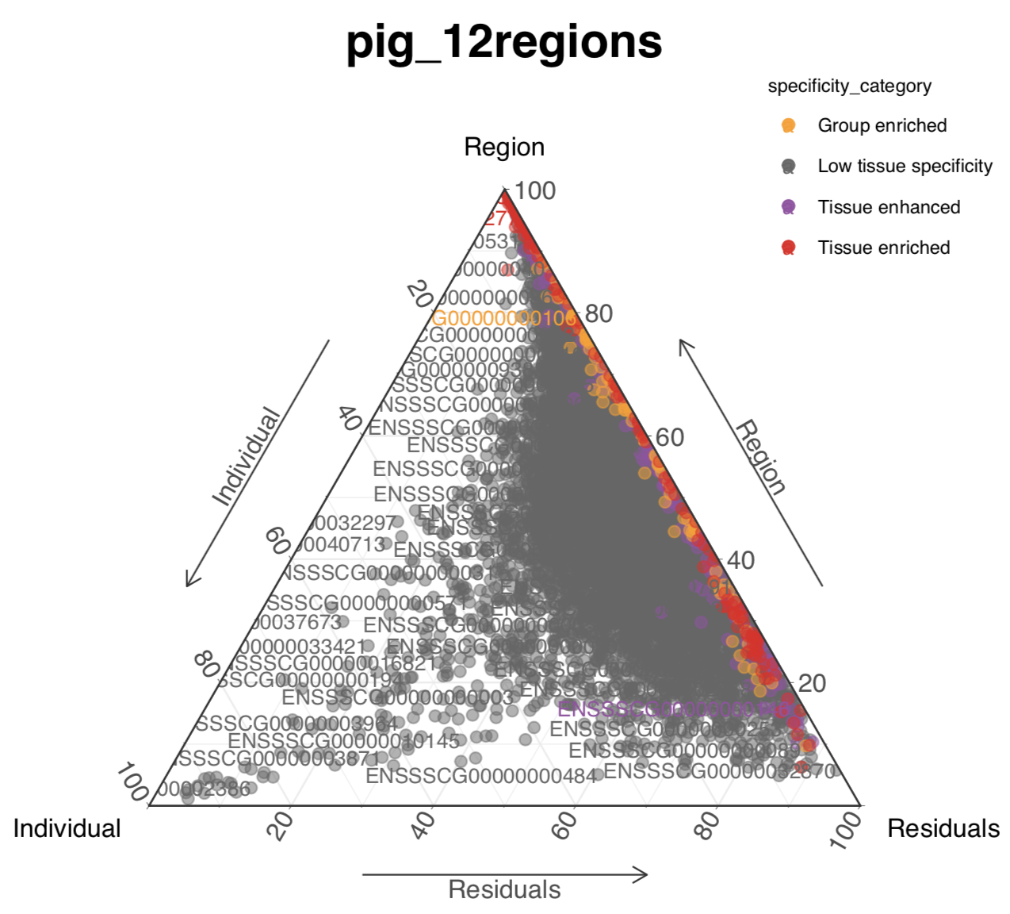
Variance analysis
Interindividual variances of most proteins are very low

Slide 11
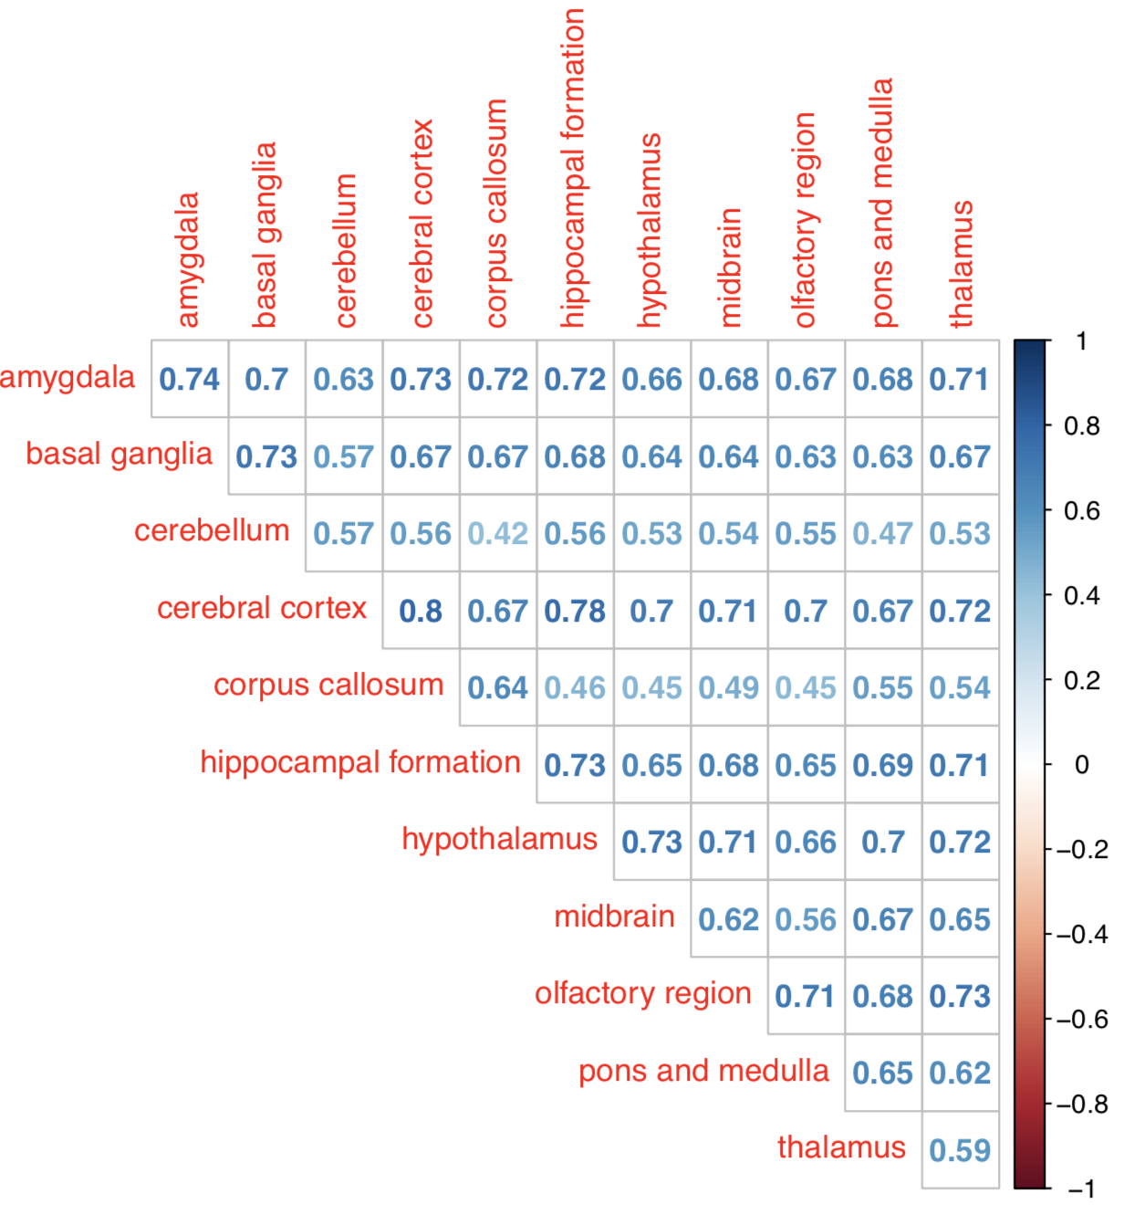
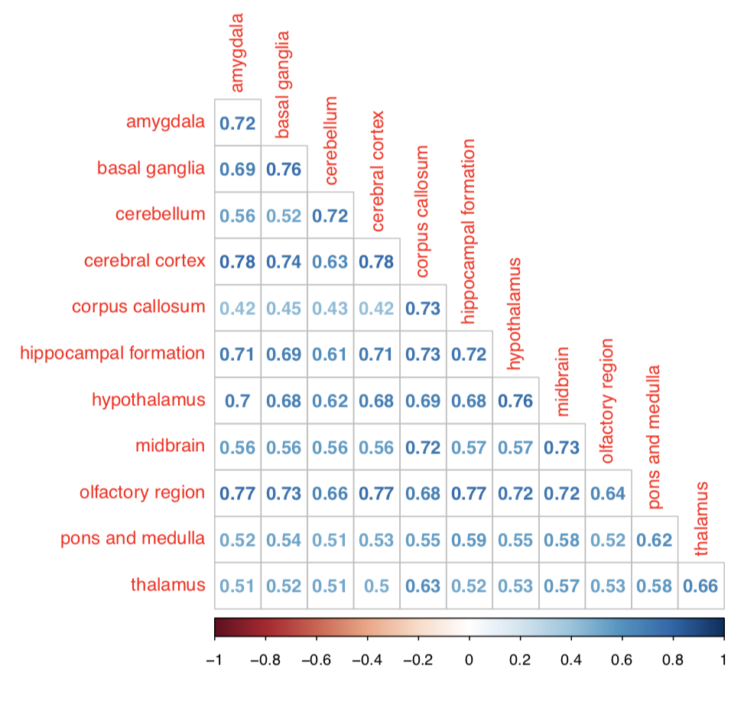
Correlation of regions
Human and pig
Human and mouse

